Slide 1



Slide 2

KHAADIM
Supervised by:
Sir Armughan Ali
Group Members:
Kiran Nisa ( FA17-BCS-074 )
Fareeha Shabbir ( FA17-BCS-103 )
Presented on
(Cs Department) COMSATS University Islamabad
Attock Campus

Slide 3
Outline
Introduction
Problem statement
Objectives
Methodology
Functional requirements
Existing apps
Tools and technology
Benefits
Diagrams
System screenshots
References

Slide 4
Introduction
“KHAADIM” is an android based mobile application that helps the political candidate to run an online campaign and share his party mandate and achievements with public to get votes and ranking.
For users it is beneficial in way that they can easily check all the candidates of certain constituency, their reputation and ranking and progress to decide that to whom they should vote for.
Communication between candidate and user is held through comments and inbox messages.

Slide 5
Problem Statement
Election campaign involves lots of money for advertisements and promotions, it requires great human effort and contribution from the political party workers (jhialaas) and is a cumbersome and daunting task. Our app has also resolved it since candidates can promote themselves and their party manifesto through this online forum.
During elections all candidates hold congregations (jalsa) for sharing and presenting their ideology and manifesto with the public. These gatherings not only cost money but also are prone to mishaps and terrorism. Our app enables the candidates to address the public online and share their vision with them.

Slide 6
Objectives
The main aims and objectives of our app are as follow :-
Online Campaigning platform.
Effective communication between the Awam and Candidate.
Popularity assessment of candidates through comments, reviews and likes.
Recommend potential candidates to the public for casting votes

Slide 7
Methodology
Candidate can add, view, delete, and update their information and posts.
User can view and comment on these posts and give reviews on candidate’s profile.
These comments and reviews are stored in database for classification using classification algorithms.
Results of these algorithm predict the ranking and progress of candidate.

Slide 8
Functional requirements
Signup
Login
Profile Management & Updation
Uploading and Posting
Comments and reviews
Recommendation
Classification of positive and negative reviews.
Live Video Communication

Slide 9
Existing Apps
Political Campaign strategy
Countable
Brigade
POLITICO
Fundamental of Politics
Icitizen
One word Politics.

Slide 10
Features of our app
Online campaigning platform
Proper profile maintenance of candidate
Personal information
Educational background
Political background
Current Position
Designation
Party mandate
Manifesto
Ranking with other candidates
Reviews of users

Slide 11
Cont..
Records of achievements
Records of reviews
Record of rankings
Analysis of reviews for ranking using classifiers.
User’s chat with candidate to share their issues.
Saving of Money, Time and effort.
Live streaming of candidate.

Slide 12
Tools and Technologies
Android studio
Firebase database
MS Word
MS PowerPoint
Visio 2013
Star UML
pycharm
Jupyter notebook

Slide 13
languages
Java
Python
Javascript

Slide 14
Diagrams
Flow Chart
Use Case Diagrams
Activity Diagrams
DFD
ERD
Class diagram

Slide 15
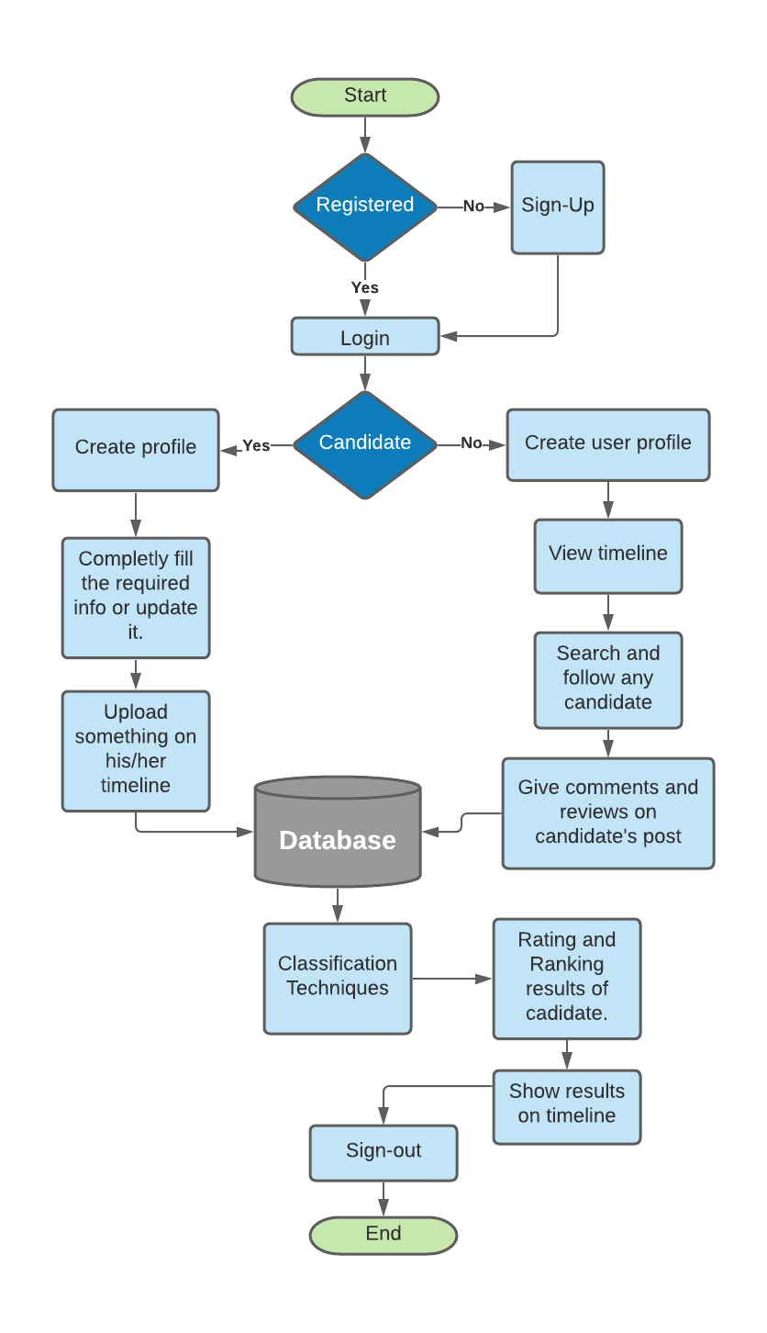
Flow chart:

Slide 16
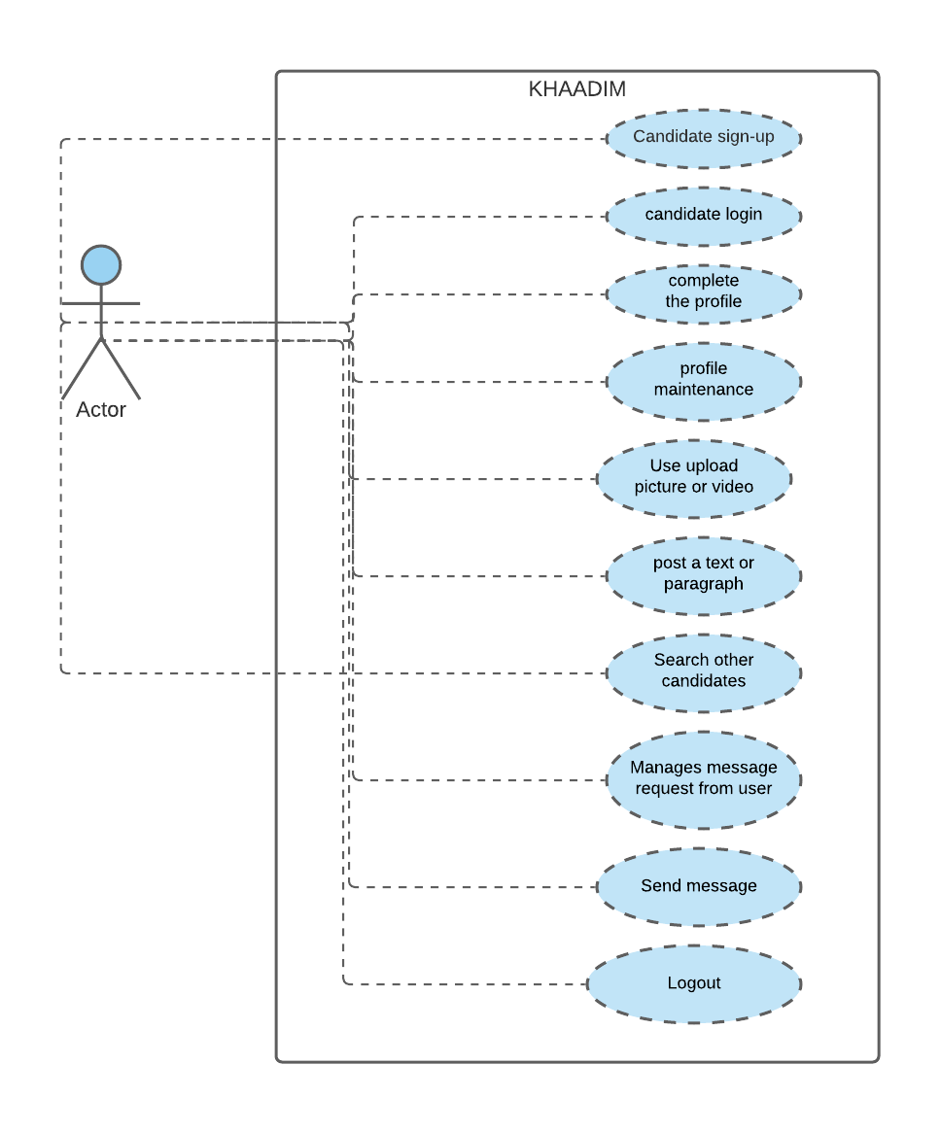
Use case:

Slide 17
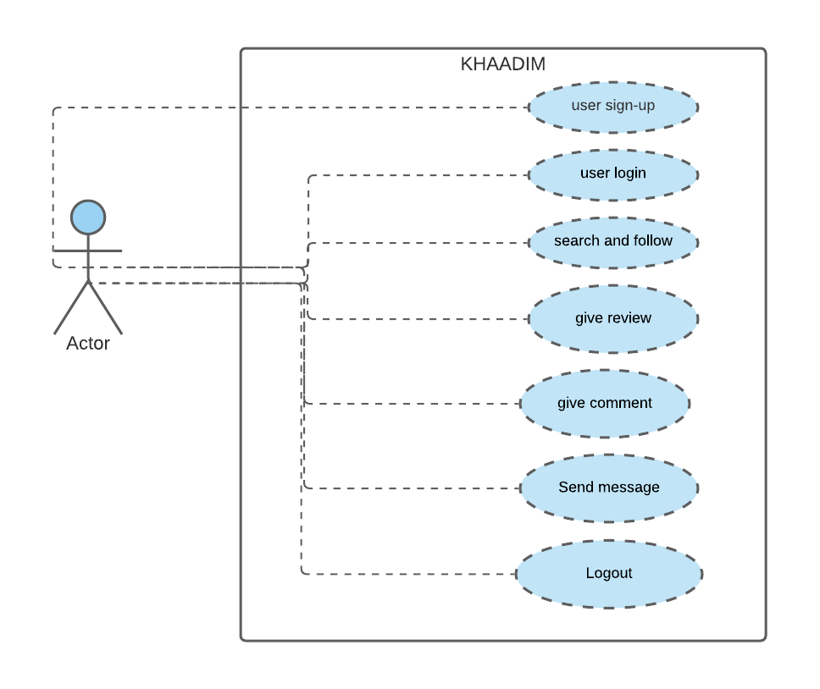
User case Diagram

Slide 18
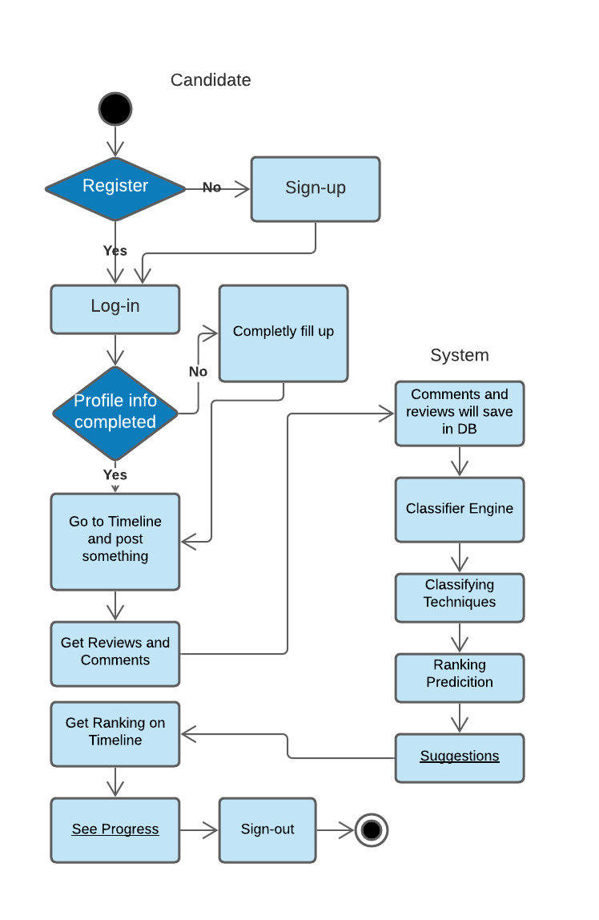
Activity Diagram:

Slide 19
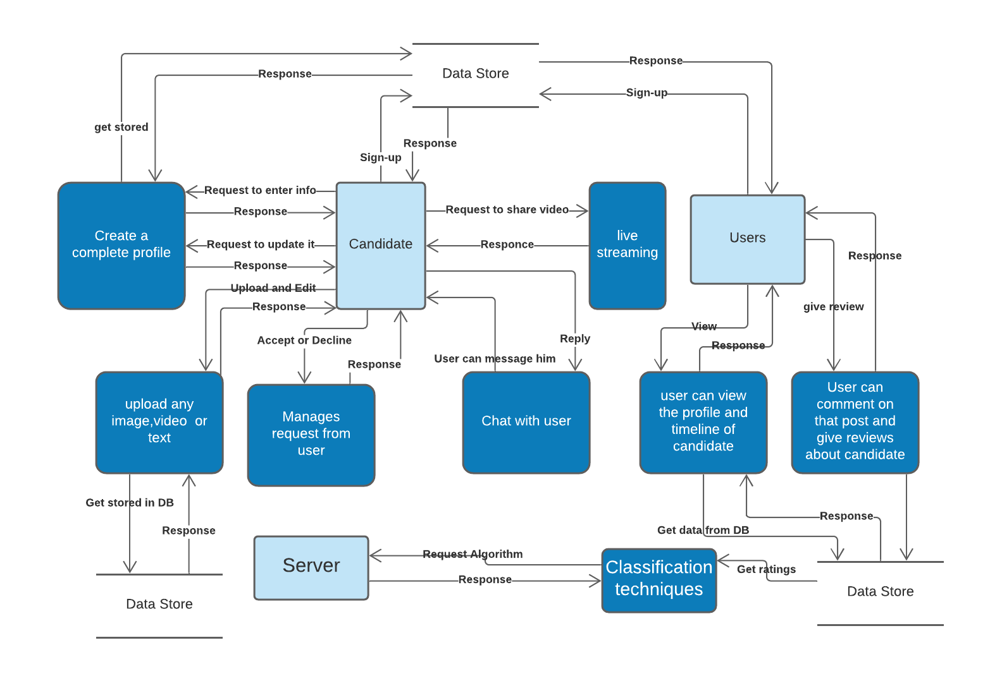
DFD(2)

Slide 20
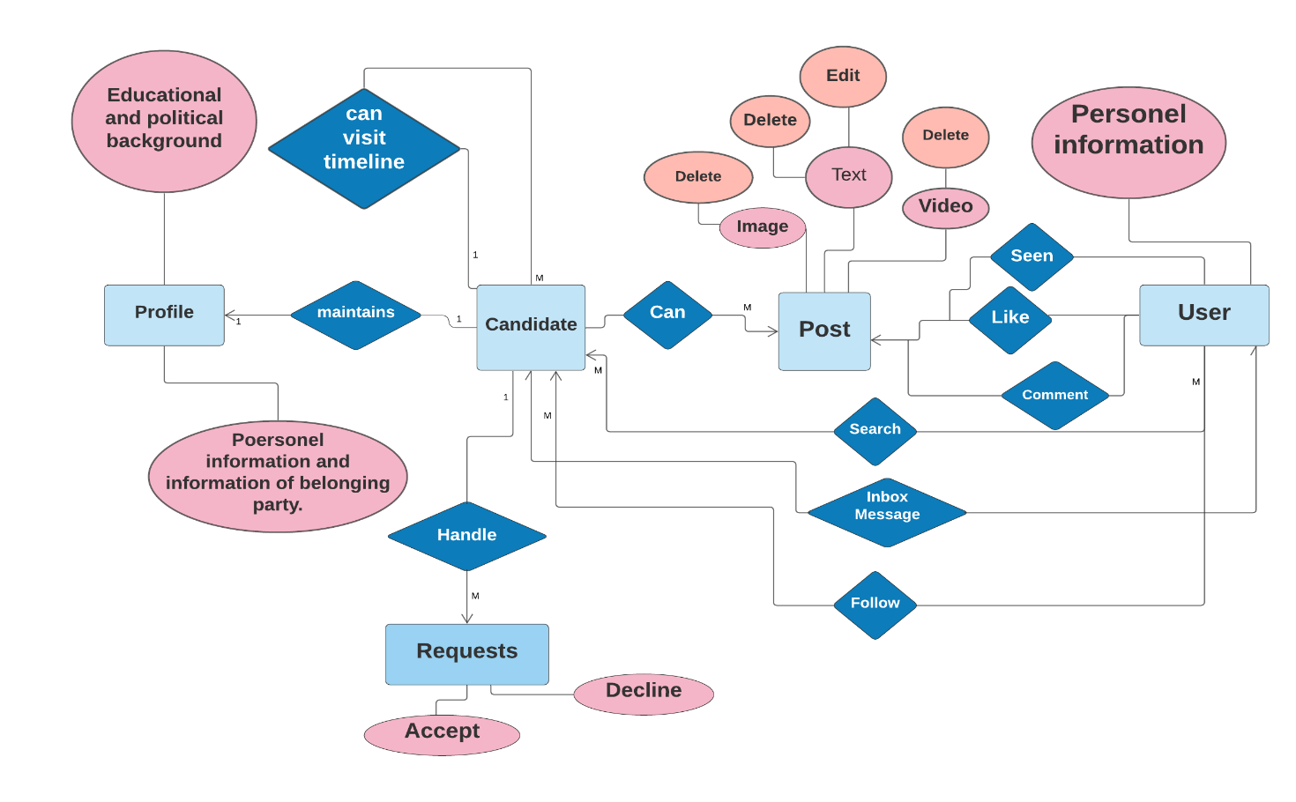
ERD

Slide 21
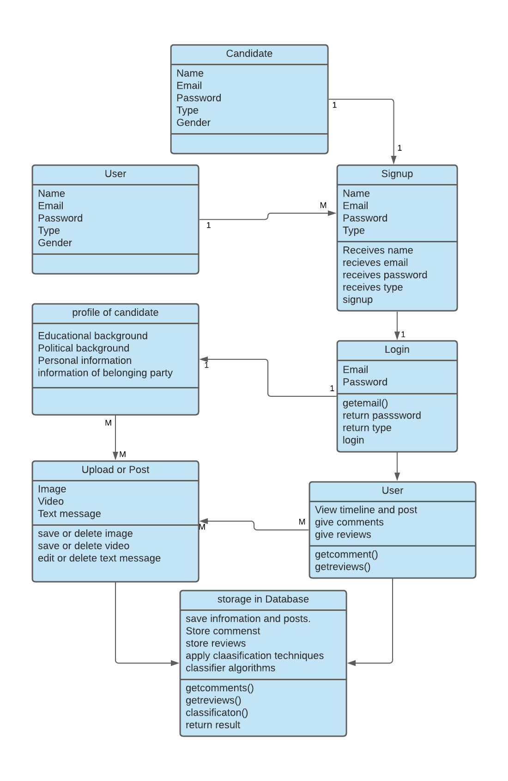
Class diagram:

Slide 22
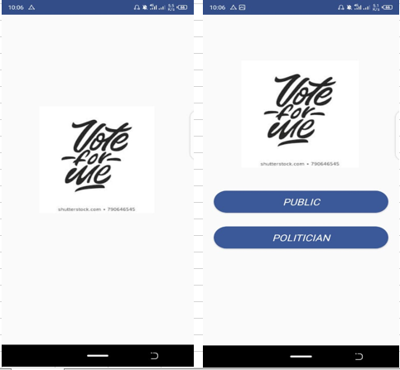
Current System
Splash screen, and start page:

Slide 23
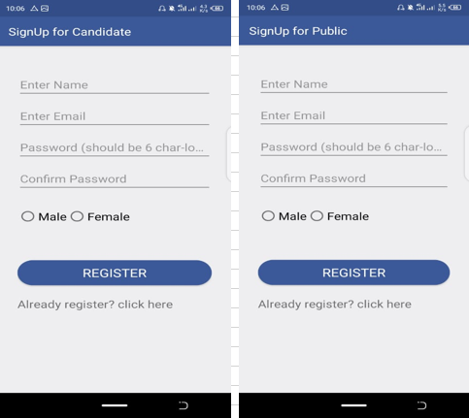
Signups

Slide 24
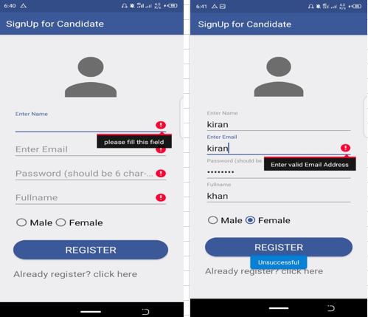
Email and Fields verification

Slide 25
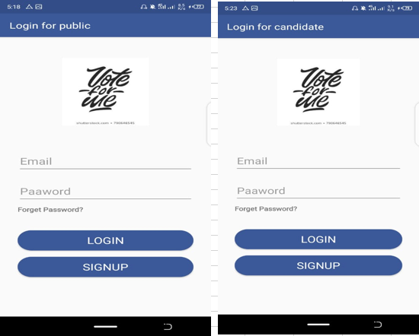
Login

Slide 26
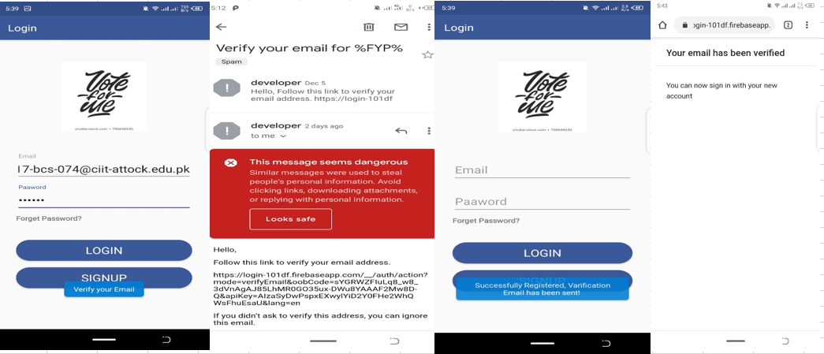
Verification of Email

Slide 27
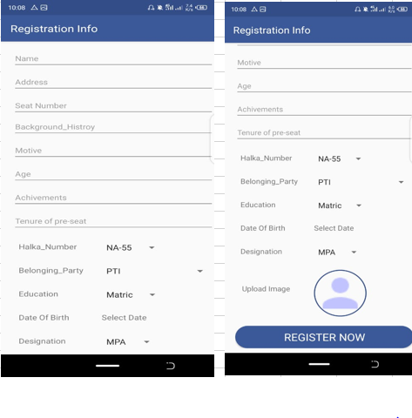
Candidate’s Registration

Slide 28
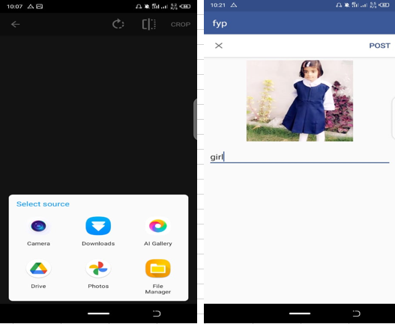
Post something

Slide 29
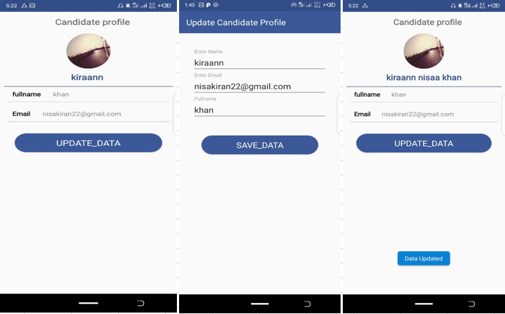
Profile Updation

Slide 30
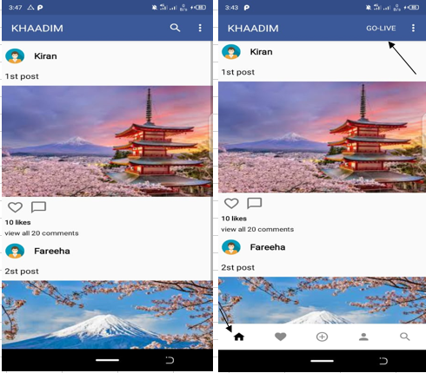
Timeline with navigation fragments

Slide 31
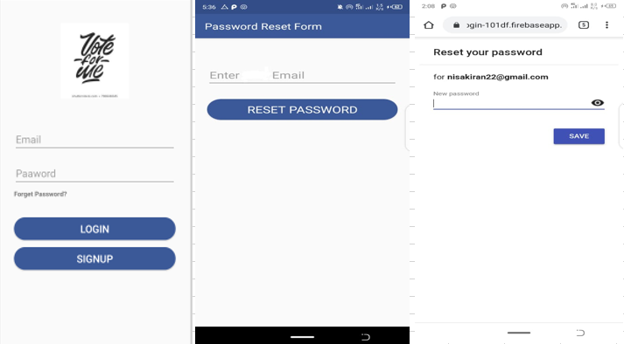
Password Updation

Slide 32
Conclusion
We have designed an android app using android studio and java language.
For data storage we have used firebase database.
There are almost 18 activities up till now.
Signup and login forms are designed to get into the app.
Email validation and verification is done.
Candidate and public users accounts and activities are handled in separate panels.
If he forget his password we created another activity which can reset the password for users.
After verifying their email the candidate will fill the registration form and able to post something.
All diagrams such as EDR, DFD, flow chart and activity diagrams are representing the complete flow of project.
Currently we are finding the dataset and studying algorithms for further processing in machine learning.

Slide 33
References
Top 10 Best Android Apps — Politics — October 2018 (androidheadlines.com)
Pang, Hua. "Is mobile app a new political discussion platform? An empirical study of the effect of WeChat use on college students’ political discussion and political efficacy." PloS one 13, no. 8 (2018): e0202244.
Goggin, Gerard. "Google phone rising: The Android and the politics of open source." Continuum 26, no. 5 (2012): 741-752.
Fundamental Of Political Science - Apps on Google Play
POLITICO - Apps on Google Play
Causes – Impact Your World Today - Apps on Google Play

